Slide 1

AOH LEADERSHIP SEMINAR
“Be the Kind of leader you would follow”

Slide 2

INTRODUCTION

Slide 3
Seminar Objectives
Today, we hope to:
  Learn qualities of effective leadership
  Better understand AOH leadership levels
  Ways to develop future leadership
  Ensure continuity of leadership and operations
  Review AOH Bluebook
  Understand proper forms and paperwork

Slide 4
Modules
I. AOH Leadership
II. Fostering Future Leaders
III. Continuity
IV. Blue Book 101
V. Paperwork and Forms
VI. Review and Roundtable

Slide 5
AOH LEADERSHIP SEMINAR
TODAY’S PRESENTERS-

Slide 6
ICEBREAKER
-Name
-Division
-How long involved
-Title
1 Trait a Leader Must Process
Where is the AOH in 10 Years?

Slide 7
REVIEW OF HANDOUTS
*AOH Manual- THE BLUEBOOK
*AOH NATIONAL CONSTITUTION (7/15)
*STATE By-Laws (Provided by State)
*AOH Form 9
*AOH Form 11
*AOH Form 12

Slide 8
Module
ONE

Slide 9
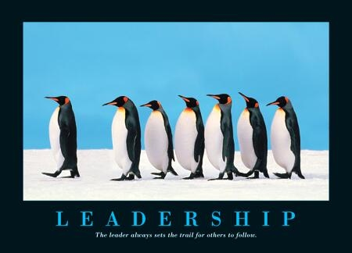
AOH LEADERSHIP
Leadership- THE ACTION OF LEADING A GROUP OF PEOPLE OR AN ORGANIZATION

Slide 10
Leadership Involves:
1. Establishing a clear vision
2. Sharing that vision with others so that they will follow willingly
3. Providing the information, knowledge and methods to realize that vision
4. Coordinating and balancing the interests of all members
5.Inspiring others to perform and engage in achieving a goal
Notes:
#2- Be transparent about vision.
#3- What resources are needed to see an initiative through?
Performance breeds trust, when a leader delivers, the confidence of others in him grows.

Slide 11
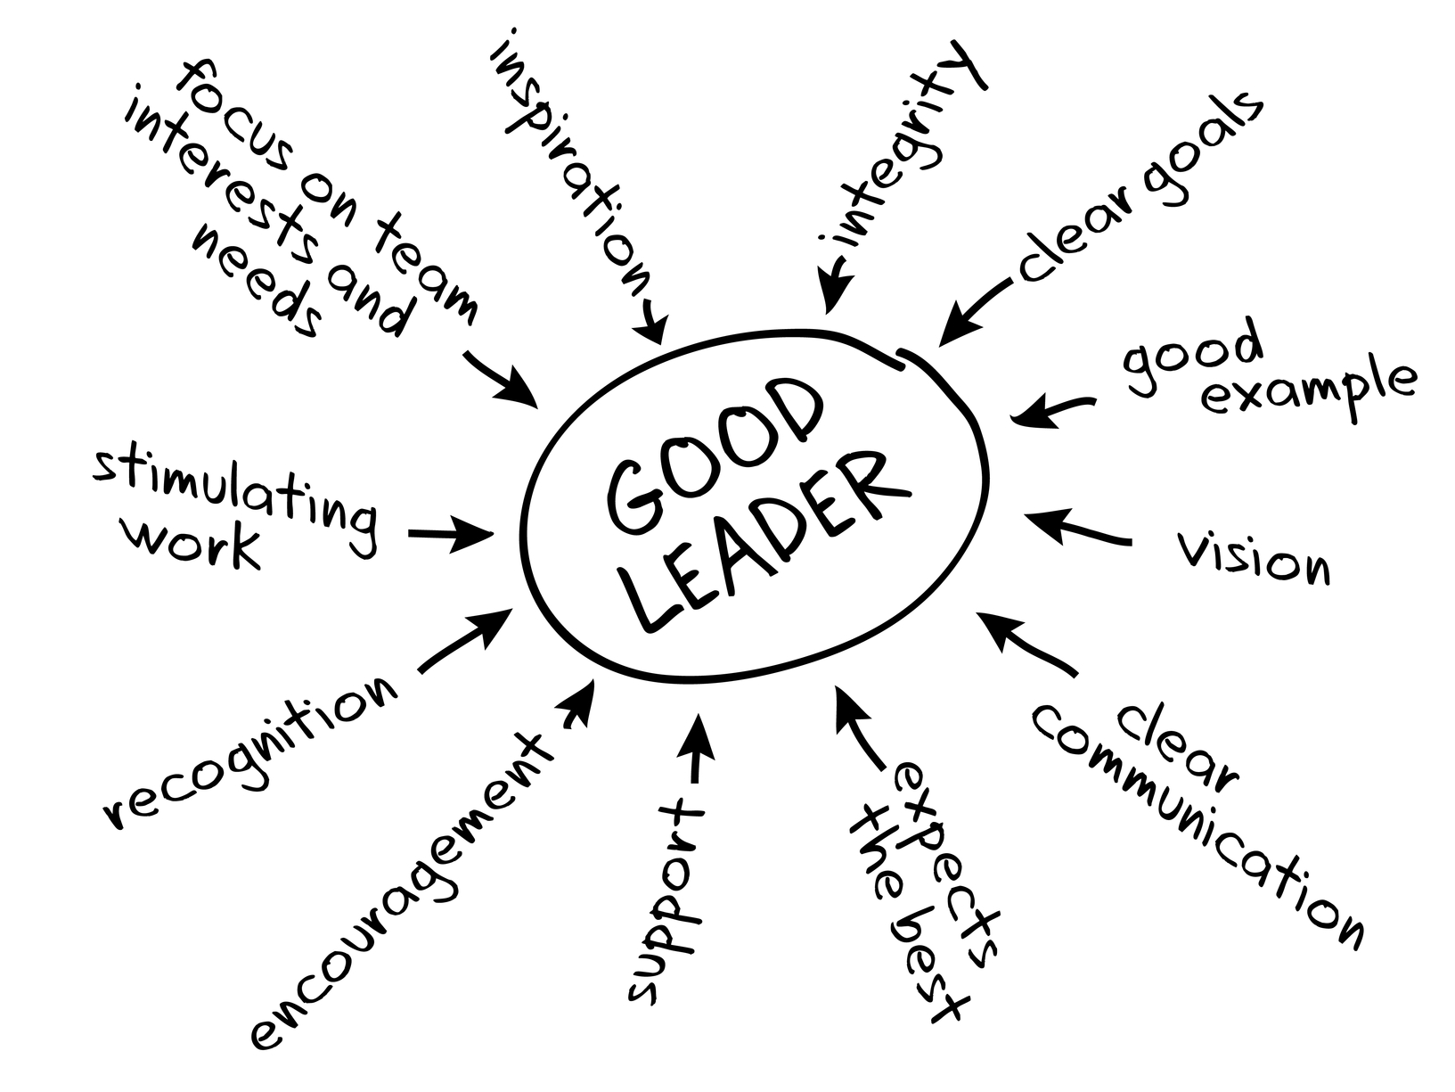

Slide 12
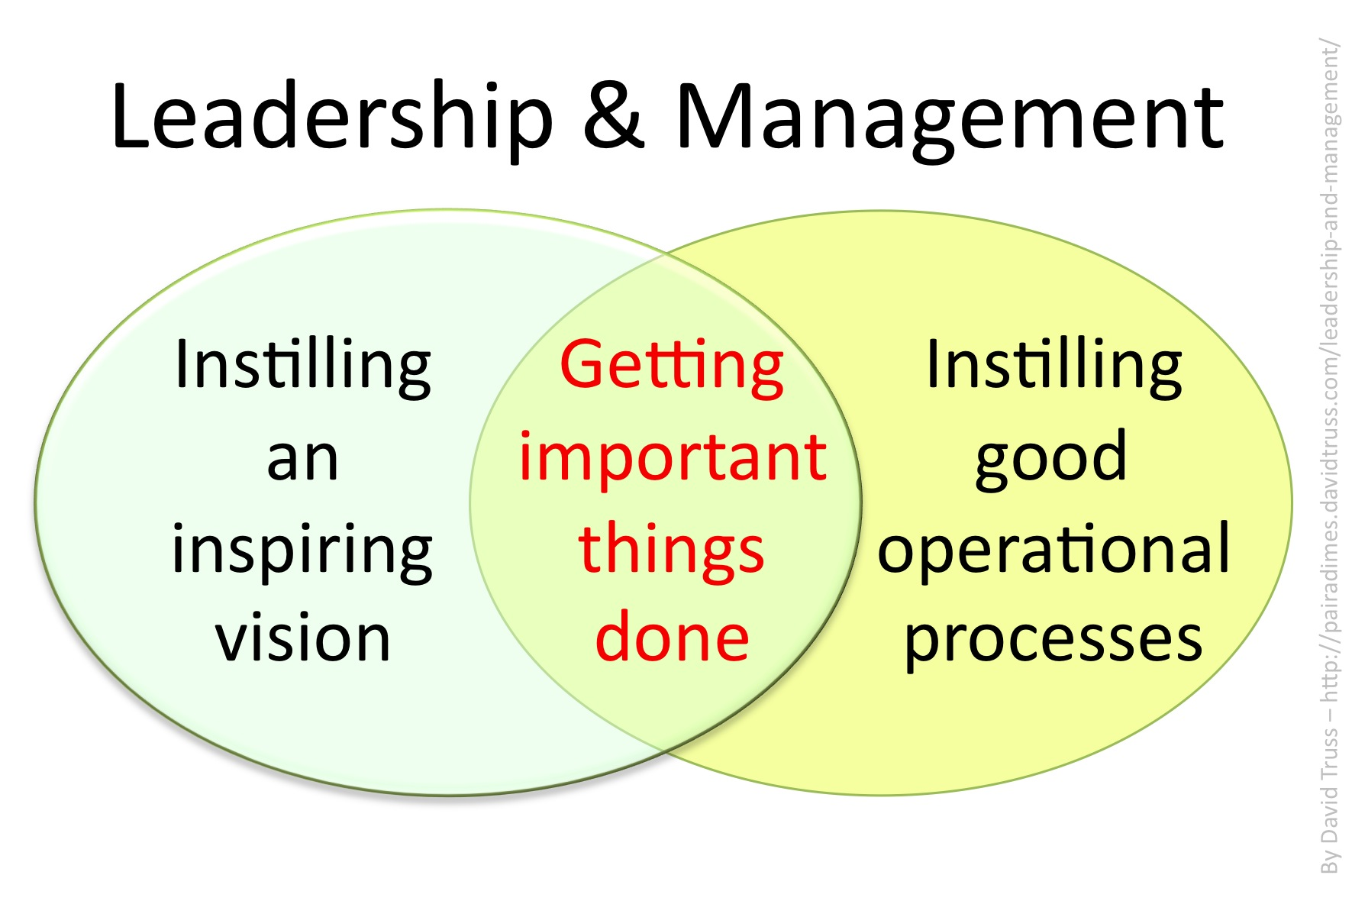
Notes:
A good leader is a resource and not a boss!

Slide 13
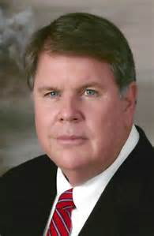
OUR LEADERSHIP
NATIONAL
STATE
COUNTY
DIVISION
JUNIOR

Slide 14
ELECTED NATIONAL OFFICERS
Article VIII Section 2
President-James McKay Art X Sec. 1
Vice President-Danny O’Connell Art X Sec. 2
Secretary-Jere Cole Art X Sec.3
Treasurer-Sean Pender Art X Sec.6
Directors (6) Art X Sec. 14
Dan Dennehy Tom O’Donnell
Liam McNabb Bill Sullivan
Denny Parks John Wilson

Slide 15
ELECTED STATE OFFICERS
Article VIII Sec. 3
(As prescribed by State By-Laws)
President Art. X Sec.1
Vice President Art. X Sec 2
Secretary Art. X Sec.3
Treasurer Art. X Sec 6
Directors

Slide 16
ELECTED COUNTY OFFICERS
Article VIII Sec. 5
(Where 2 or Divisions exist within the County)
President Art. X Sec.1
Vice President Art. X Sec 2
Recording Secretary Art. X Sec 4,
Financial Secretary Art. X Sec 5
Treasurer Art. X Sec. 6
Marshal Bluebook Pg 27
Sentinel Bluebook Pg 27
Chairman of Standing Committee Bluebook Pg 27

Slide 17
ELECTED DIVISION OFFICERS
Article VIII Sec.7
President
Vice President
Recording Secretary
Financial Secretary
Treasurer
Marshal
Sentinel
Chairman of Standing Committee

Slide 18
APPOINTED OFFICERS
Chaplain Art X Sec 7,8
Historian/Archivist Art X Sec 9,10
Organizer Art X Sec 12,13
FFAI Art X Sec. 15
Charities and Missions Art X Sec 16,17
Catholic Action Art X Sec 18
Pro-Life Art X Sec 20
Political Education Com Art X Sec 21
Veterans Affairs Art X Sec 22
Immigration Art X Sec 23

Slide 19
OTHER APPOINTED OFFICERS
Newsletter Editor
Legal Counsel
Sports
Project St. Patrick
Hunger
Fundraising
Directors
Finance/Trustees
Rituals

Slide 20
Leadership…Investing in the Order
Leadership is important on every level (National State, County & Division) for the health and well being of the Order.
Critical functions of Leaders is to:
    Engage others (Officers and Members)
    Identify goals for the term (what are desired outcomes?)
    Develop a work plan
    Coach and Mentor
    Set an Example for others
    “Plant seeds” for the future

Slide 21
Engage Others…Build Your Team
Involve others to discuss operations for today and the future:
  What do they think is important for the organization? (Buy-In is critical…)
  What can they do to help? (any skills, talents, etc.?)
  Who else can join the mission?
Notes:
Promote the sharing of skills beyond constitutional duties. Example, a Recording Secretary can do so much more….

Slide 22
Knowledge is Power
“Setting the Stage”
Know your job!!! (Respect lines of authority, etc.)
What are the duties and expectations of each Officer (Blue Book)?
Leaders need to be a resource or “Go To” for others to learn more about the Order, Officer’s duties, procedures, etc.
Who is playing what role as it relates to operations, initiatives, etc.?
Talk openly about the duties of Officers as it will help others better understand operations of the Order.

Slide 23
Identify Goals for Term
What are your priorities? What is important to others?
Timeframes?
Measuring success (how will you know you achieved your goals?)
Ownership is critical for “Buy In”
Talk openly about goals (distinguish short term and long term goals)
Who else can serve as key leaders?

Slide 24
Develop a Work Plan
  What are the steps to achieving the group’s goals?
Division, County, State Level Operations:
      Who are the key leaders?
      What is everyone’s role?
      Are they fully aware of their role?
Initiatives, Special Projects:
      Who are the key leaders?
      What is everyone’s role?
      What resources are needed? (funding, committees, partnering with LAOH, other community organizations, etc.)
Do you have a theme? Liam’s example: “Give a Member a reason to be here, give him a reason to stay.”

Slide 25
Coach and Mentor
Follow up with everyone:
  Need to check in and show support, encouragement.
  What is working well and what isn’t?
  What can you do to help?
  Are more or different resources needed?
  Promote and celebrate successes.
Notes:
-Everyone wants to feel valued and supported.
-Everyone wants leadership to take notice of their efforts.
-Everyone wants to be part of success and it breeds more success.
-Momentum is critical, keep it going.

Slide 26
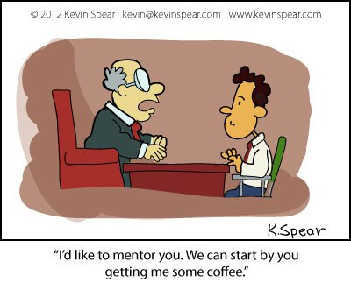
Mentoring: Investing in Others

Slide 27
Mentoring
Starts at Recruitment
Mentor is also a advocate
Ongoing
Formalizing a program within Division
Building the Farm team

Slide 28
Serve as an Example for others
Always be professional (members and officers are always watching you)
Be positive and solution focused
Highlight strengths of others
Don’t assign a duty you haven’t performed yourself
If you represent the Order with integrity, others will follow

Slide 29
Review:
Top 10 Qualities that make a Leader
Honesty Positive Attitude
Delegate Creativity
Communication Intuition
Confidence Inspire
Commitment Approach
“The most powerful leadership tool you have is your own personal example”
                John Wooden
Notes:
Delete????? Duplicative

Slide 30
Module
TWO

Slide 31

Fostering Future Leaders

Slide 32
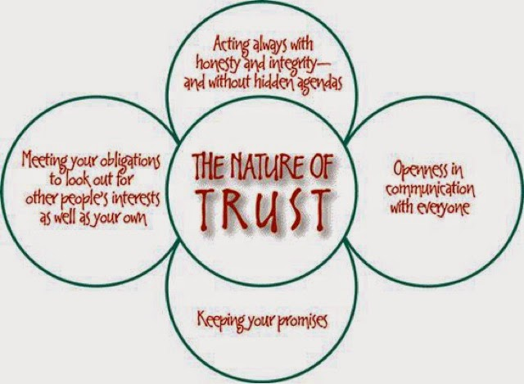
Gain Interest and Trust

Slide 33
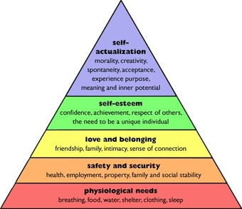
Maslow’s Hierarchy of Needs

Slide 34
Assign Tasks
Start Simple if needed
Committee Assignment
Use Skills/Specialty
Age Appropriate
Teamwork

Slide 35


Millennials

Slide 36
Millennial
-A Millennial is the name given to the generation born between 1982 and 2004. The Millennial generation follows Generation X (1961-1981) in order of demographic cohorts. This Generation is often associated with technology and social media. Also known as Generation Y
CURRENTLY THE 2nd LARGEST GENRATION IN THE UNITED STATES

Slide 37
Millennial
-Millennial have come to age during a time of technological change, globalization and economic disruption . That’s given them a different set of behaviors and experiences than their parents
-Are often considered young, smart and brash
-While they want to work, they do not want their work to be their entire life
-They have been have been nurtured and programmed with a slew of activities since they were toddlers, meaning they are both high performers and high maintence
-They are considered multitaskers

Slide 38
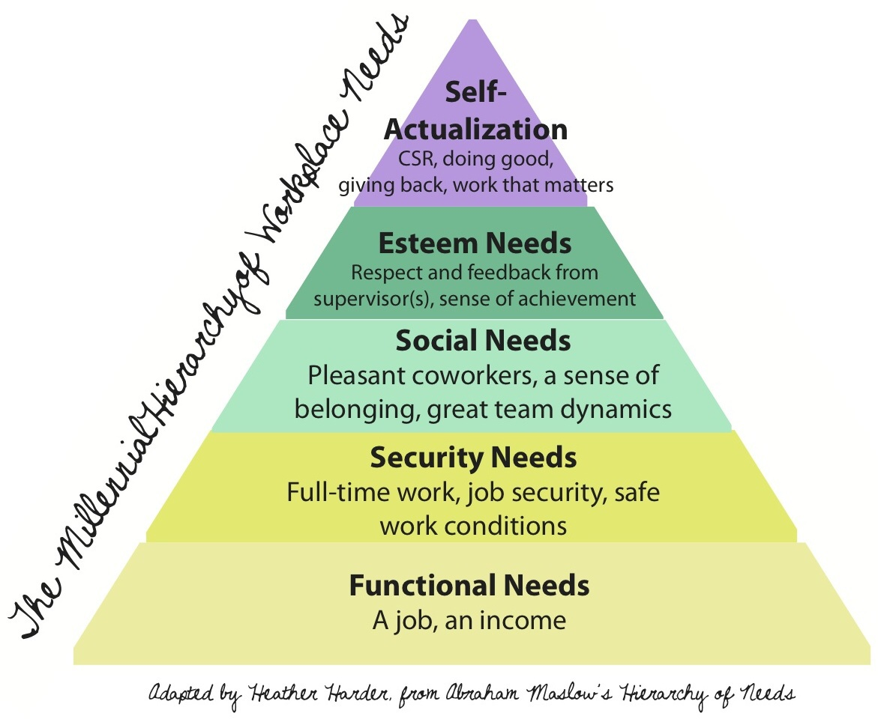
Millennial Hierarchy of Needs

Slide 39
Module
THREE

Slide 40

Continuity

Slide 41
What is Continuity?
The Unbroken and Consistent existence or operation of something over a period of time.

Slide 42
Continuity=Survival
Plan for the Future…
Invest in the Order

Slide 43
1. Adapt to Change
-Changes in:
-Society
-Culture
-People
-The Organization

Slide 44
2.Embrace Technology
-Social Media
-Webinars
-Communications
-Emerging Tech

Slide 45
3. Run it like a Business
-Budgeting
-Team Building
-Overall Vision
-Yearly Review

Slide 46
4.Fix what needs it
-Term Limits
-1 year vs. 2 year
-Group Solutions
-Avoid age old mistakes

Slide 47
5. Plan for the Future
Develop 5 year and 10 year plans
Encourage advancement of Officers- moving up the Chairs
Develop officers (members “shadowing” current Officers)
Fundraising and setting budget goals
Long Term Goals (What can we do now to ensure the Order is healthy in 10 years?)

Slide 48
6. Hand off the Torch
Prepare others for new roles.
Know when it’s time to step back.
Challenge others by challenging yourself:
  A member without a “track record” doesn’t mean he can’t do a job
  Have faith in others to continue to mission
Conflict or inactivity may lead to a takeover
Keep focus on “the Good of the Order”
Notes:
The Order is about us and not me, it is we and not I. Egos can negatively impact our work and therefore impact the Order.

Slide 49
MODULE
Four

Slide 50
BLUE BOOK 101

Slide 51
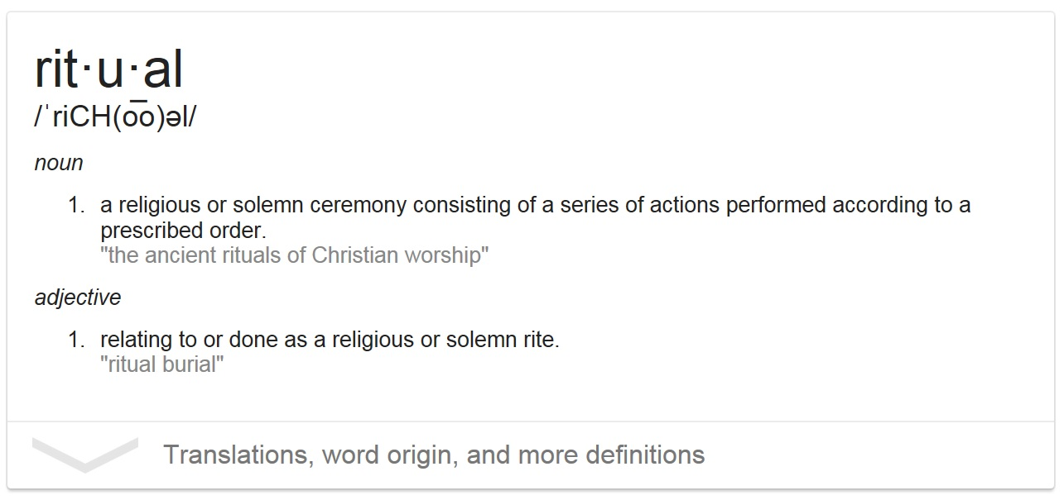
Define Ritual

Slide 52
THE AOH BLUEBOOK
A Manual for the Guidance of Officers in the Management of Divisions, Explaining the Methods of Conducting Meetings, Modes of Installations, Ceremonies for Deceased Members and Initiatory Ceremonies.
Contains Preamble to AOH Constitution (pg 2)
Describes Div. Meeting Order (pg 3 - 5)
Shamrock Degree (pg 6 - 12)
Nomination and Election of Officers (pg 12 & 13)
Installations (pg 13 - 18)
Ritual at Wake of member (pg 19)

Slide 53
THE AOH BLUEBOOK
Memorial /Draping of Charter (pg 19 & 20)
Mode of Reception of Ranking Officers (pg 20)
Suggested Order of Business for County Board Meeting (pg 21)
Describes Emblems and Symbols (pg 21)
Describes Proper Appearance of Meeting Hall (pg 22)
Describes Decorum at Meetings (Pg 22 & 23)
Contains Song Sheets (pg 24 & 25)
Contains Irish Language Prayers (pg 26)
Describes the Duties of AOH Officers (pg 27 & 28)

Slide 54
WHY WE USE THE BLUEBOOK
-Mandated (Art. XXII Sec. 1)
-Used throughout the whole organization
-Provides a Universal Procedure
-Easy to follow

Slide 55
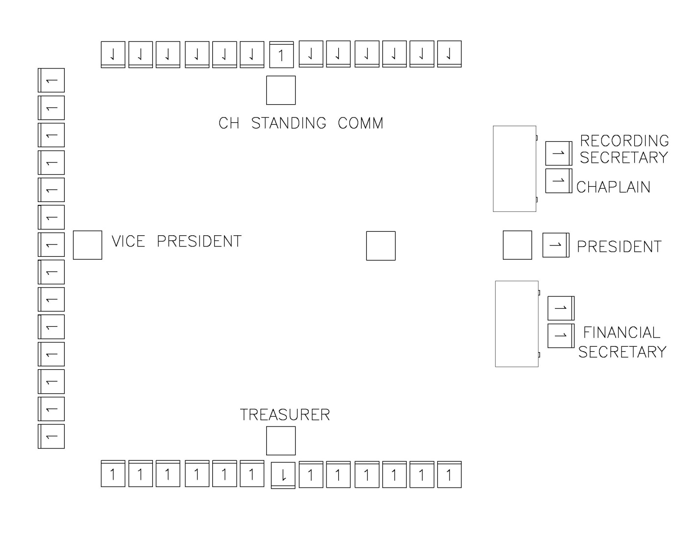
Mock Meeting Set up

Slide 56
Robert's Rules
The first edition of the book, whose full title was Pocket Manual of Rules of Order for Deliberative Assemblies, was published in February 1876 by then U.S. Army Major Henry Martyn Robert (1837–1923) with the short title Robert's Rules of Order placed on its cover.
Robert’s Rules provides rules and procedures that allow a deliberative assembly to make its decisions efficiently, but with all due regard for the rights of the minority. Following the rules ensures more a fair and more achievable outcome without wasting time.

Slide 57
Ritual Review Committee
-Last revision to the Bluebook was 2000
Suggestions?

Slide 58
MODULE
FIVE

Slide 59
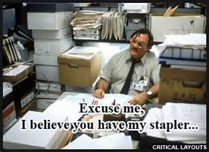
Paperwork and Forms

Slide 60
IMPORTANCE

Slide 61
UNIFOMITY

Slide 62
PROPER USE

Slide 63


TAXES

Slide 64
MODULE
SIX

Slide 65
Review of Objectives
Today, we hoped to:
  Learn qualities of effective leadership
  Better understand AOH leadership levels
  Ways to develop future leadership
  Ensure continuity of leadership and operations
  Review AOH Bluebook
  Understand proper forms and paperwork

Slide 66

ROUNDTABLE DISCUSSION

Slide 67
Sharing Successes and Challenges
Examples of great leaders in your area?
What has worked well in your Division?
What challenges have you experienced and overcome?
Other thoughts?

Slide 68

SUGGESTIONS

